Slide 1
Table of Contents
The Initial Question
Exploratory Data Analysis:
Heatmaps
A new Question
Time Series Graph
The Broader Questions
Prediction Model

Slide 2
The Initial Question
Are tech companies relocating?
Have tech companies attempted to move away from busier central areas of a market after covid and the advent of remote working?

Slide 3
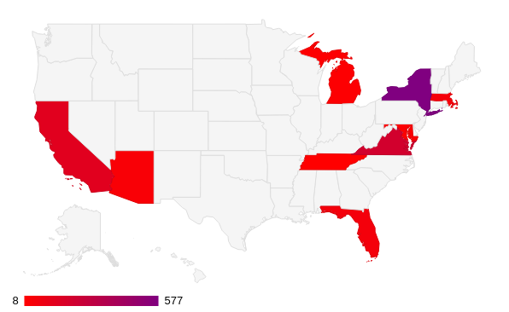
The How
How did we explore this data?
Geographical Heatmap
We designed an simple heatmap that just showed the amount of relocations in the tech industry by state.
Now all that was left to do was to explore where the relocations were happening more precisely.
Notes:
We noticed that New York had a predominantly high amount of relocations and data to work with

Slide 4
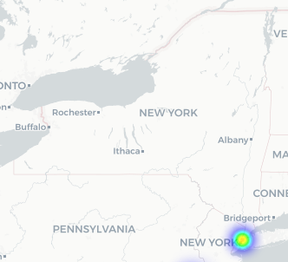
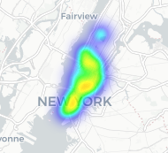
The How
A more precise look
Interactive Heatmap and the Answer
An external dataset that included zip codes and their geographic coordinates
We managed to plot the exact locations on a heatmap
The heatmap showed us that the answer to our initial question: No. Most tech companies remain within New York City, and more specifically within Manhattan.
Notes:
We utilised an external dataset that included zip codes and their geographic coordinates, merging this with all relocations within New York we managed to plot the exact locations on a heatmap.

Slide 5
The Secondary Question
Where are tech companies leasing?
Exploratory data analysis shows:
STILL New York City
Is this reflective of every industry?
Has this changed within the past few years?

Slide 6
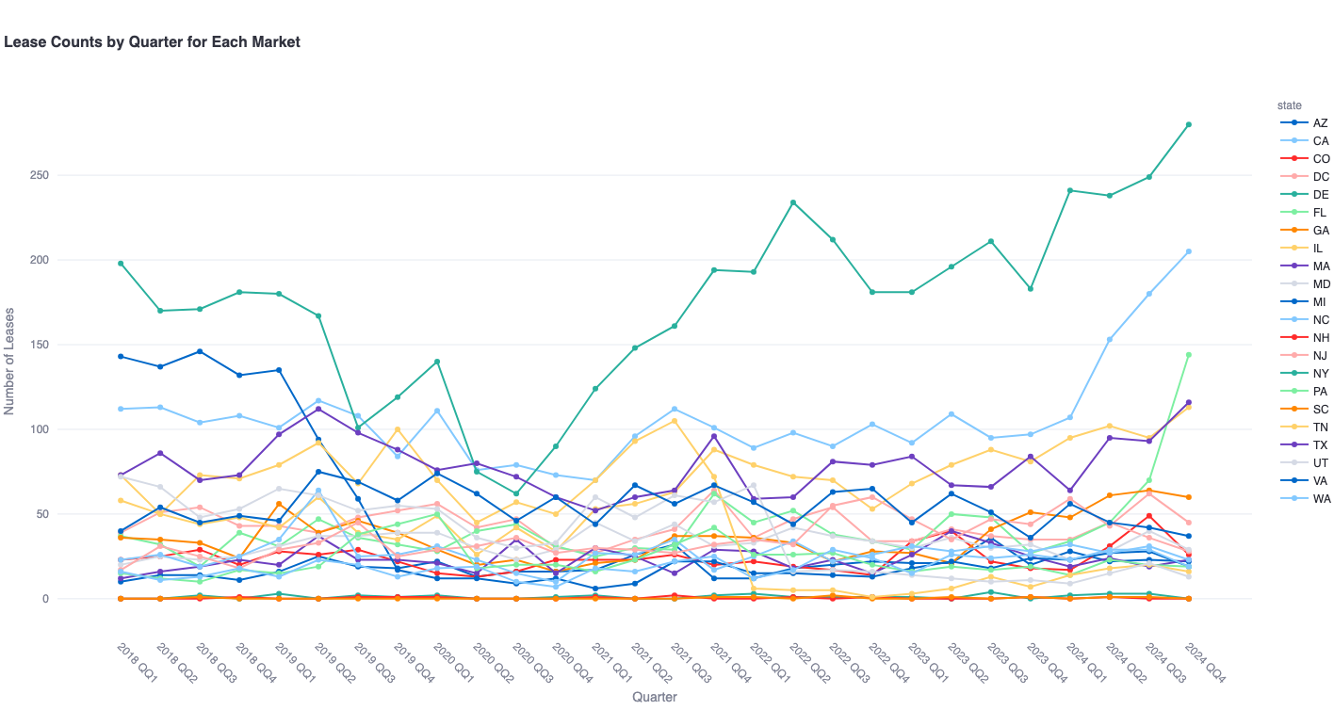
The How
Further Analysis
Time Series Graph
After covid, New york became a more attractive market for all industries to lease office space with California close behind
But, do specific industries prefer specific cities or states?
Notes:
But how does the number of leases signed in a market change over time.
We developed an interactive tool that allows you to visualize how a company’s industry and its preferred transaction type affect the number of leases signed over time
Helps answer the original question
We found that after covid, more leases were signed in New york. In fact, new york represented most of the signed leases across each industry

Slide 7
Zooming Out
The Broader Questions
How can we visualize the lease activity for specific industries?
A wider interactive heatmap
A bar chart comparing the states for each industry

Slide 8
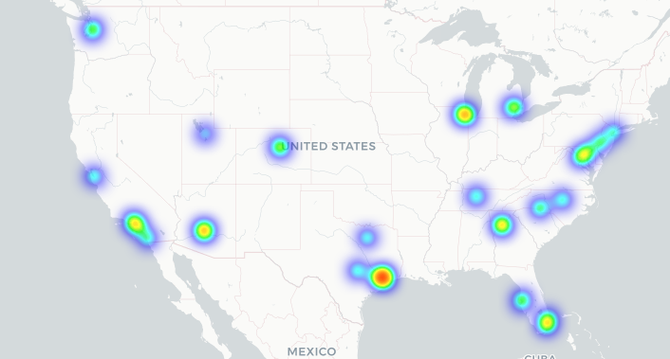
The How
Further Analysis
Filterable Interactive Heatmap
We expanded the scope of the heatmap to all of the USA and every industry
This revealed hot spots not previously noticed through the tech industry alone and the ability to observe through map through specific industries

Slide 9
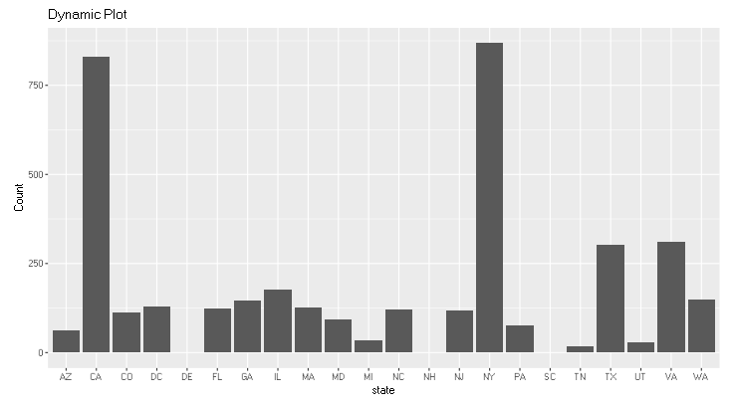
The How
Further Analysis
Filterable Bar Chart
The filterable bar chart works to explore the amount of leases within an industry in regards to each state, this gives us a more numerical representation of the concentration of industries.

Slide 10
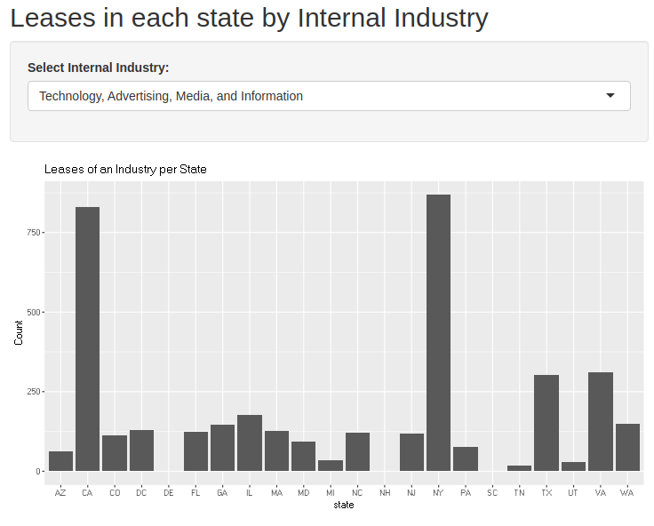
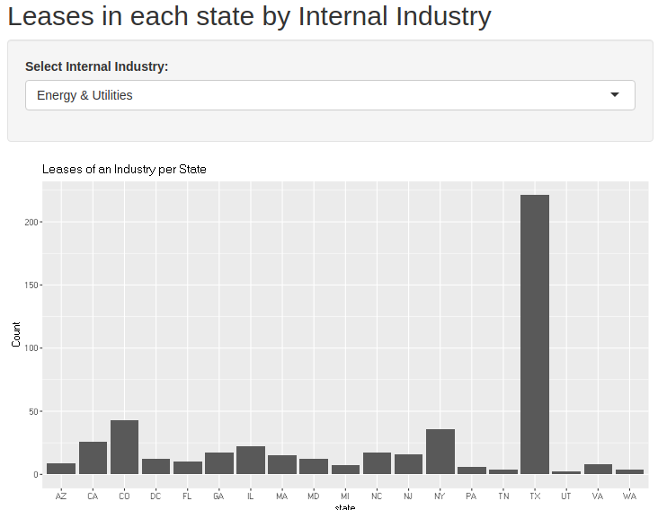
The Results
Exploratory Findings
Filterable Bar Chart
Works in a similar manner to the heatmap
Shows that industry DOES matter
There can be incredible variety in regards to industry

Slide 11
The Model
Exploratory Findings
Can we predict the best location for each industry?

Slide 12
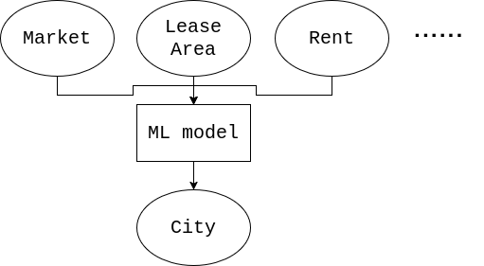
The How
Predicting suitable office spaces using multivariable linear regression
Limitations: Uses simple linear regression model which is unable to model complex non linear relationships in the data
Improvements: Use a neural network with non linear activation functions
Notes:
Goal: predict suitable location (the city) for an office space given some initial information that a client would likely have
Like market, area of office, rent,
Linear regression model to predict
Limitation - linear, covid data

Slide 13
Exploratory data analysis shows:
Companies stayed dominantly within the New York city central area
Despite covid and remote working, tech companies did not move
Possible Inaccuracies:
Imbalance of data in different market
Word of mouth data is sometimes unreliable

Slide 14


Thank you all for listening

